Slide 1
Chomsky Normal Form
---Sakshi Surve

Slide 2
Normal Forms:
By reducing the grammar, the grammar gets minimized but does not get
standardized.
This is because the RHS of productions have no specific format.
In order to standardize the grammar, normalization is performed using
normal forms.

Slide 3
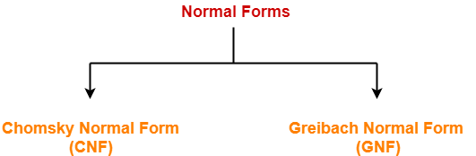

Slide 4
Chomsky Normal Form-
A context free grammar is said to be in chomsky normal form (CNF) if all its productions are of the form-
A → BC
or
A → a
where A, B, C are non-terminals
a is a terminal.

Slide 5
Steps :
Reduce the grammar completely by-
Eliminating ∈ productions
Eliminating unit productions
Eliminating useless productions
Add to the solution the productions which are already in CNF
For the remaining non CNF productions,
Replace the terminals with some variables
Limit the number of variables at RHS to 2

Slide 6
Example 1
Convert the given grammar to CNF-
S → aAD
A → aB / bAB
B → b
D → d

Slide 7
Step-01:
The given grammar is already completely reduced.
Step-02:
The productions already in chomsky normal form are-
B → b ………..(1)
D → d ………..(2)
These productions will remain as they are.

Slide 8
The productions not in chomsky normal form are-
S → aAD ………..(3)
A → aB / bAB ………..(4)
We will convert these productions in chomsky normal form.
Step-03:
Replace the terminal symbols a and b by new variables R1 and R2.
This is done by introducing the following two new productions in the grammar-
R1 → a ………..(5)
R2 → b ………..(6)

Slide 9
Now, the productions (3) and (4) modifies to-
S → R1AD ………..(7)
A → R1B / R2AB ………..(8)
Replace AD and AB by new variables R3 and R4 respectively.
R3 → AD ………..(9)
R4 → AB ………..(10)
S → R1 R3 ………..(11)
A → R1B / R2R4 ………..(12)

Slide 10
From (1), (2), (5), (6), (9), (10), (11) and (12), the resultant grammar is-
S → R1R3
A → R1B / R2R4
R1 → a
R2 → b
R3 → AD
R4 → AB
B → b
D → d
This grammar is in chomsky normal form.

Slide 11
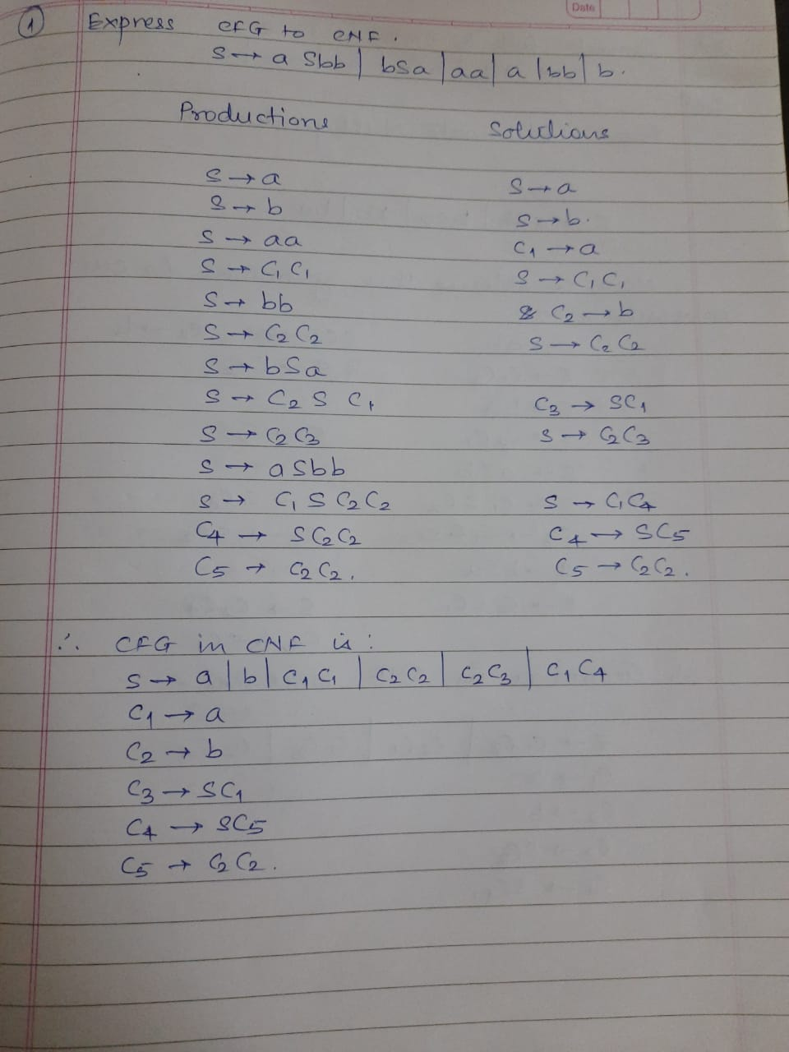

Slide 13
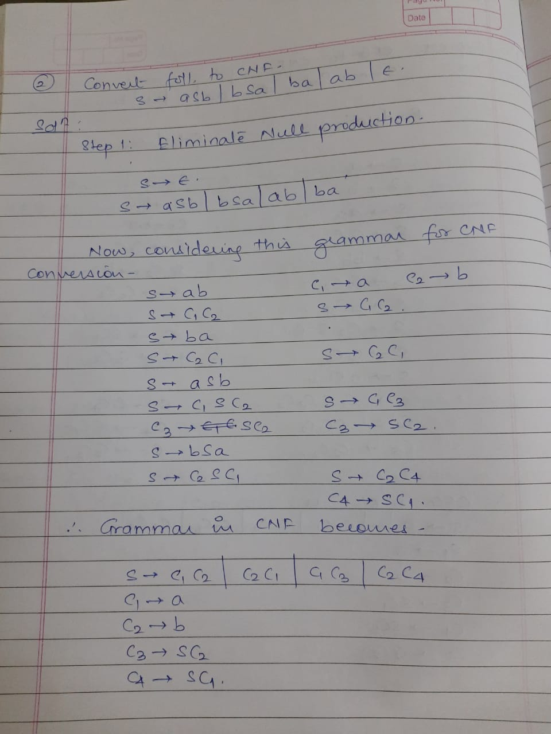

Slide 16
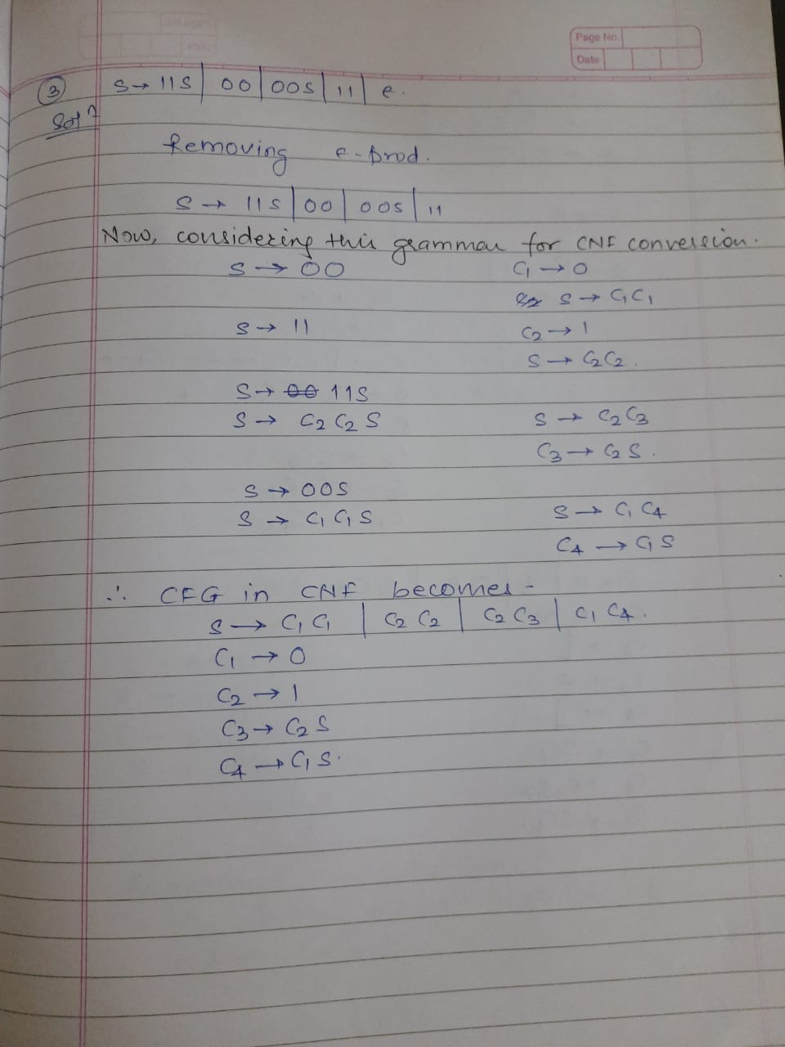

Slide 18
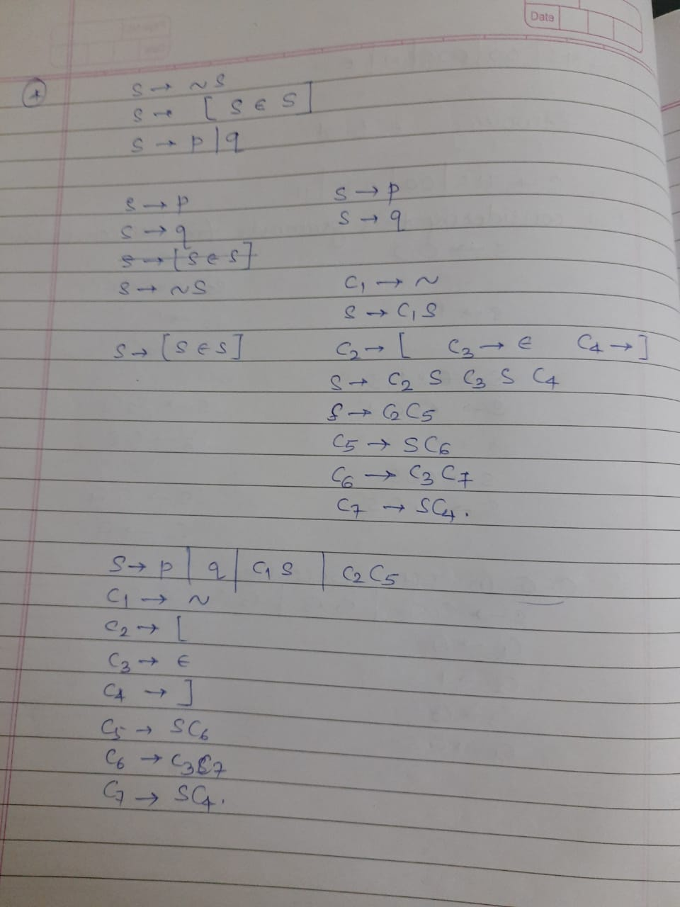

Slide 20
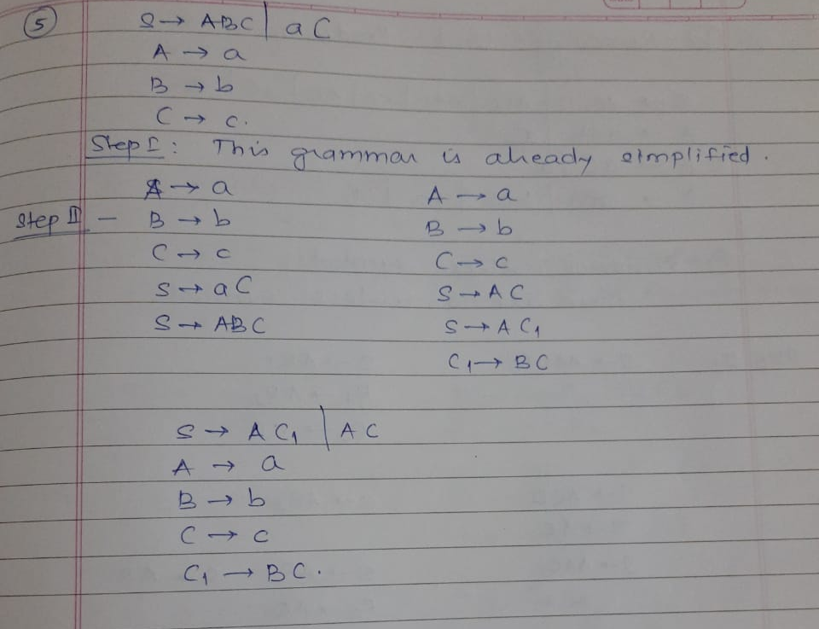

Slide 21
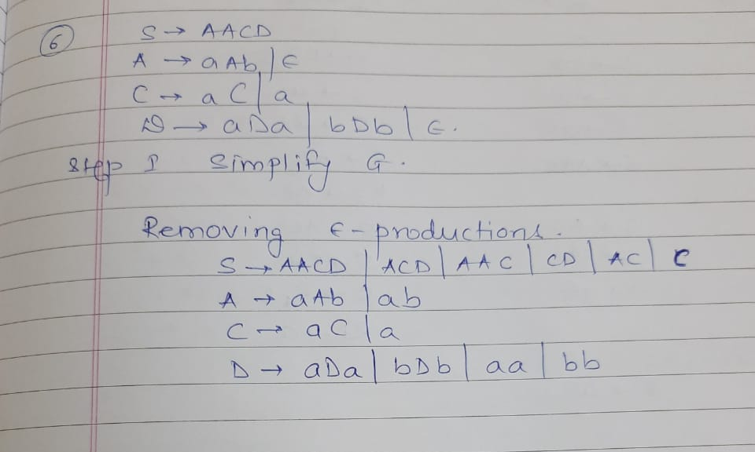

Slide 22
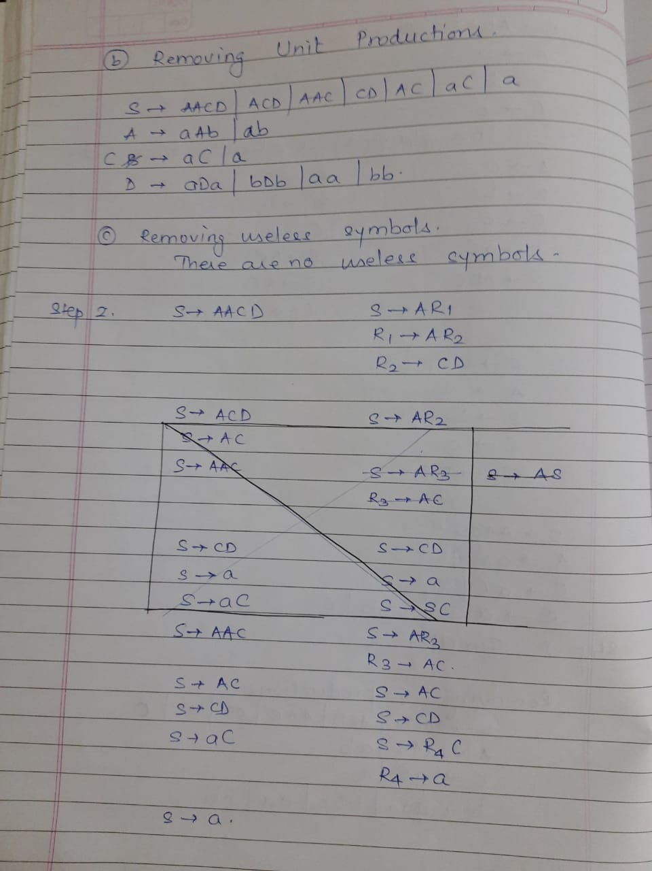

Slide 24
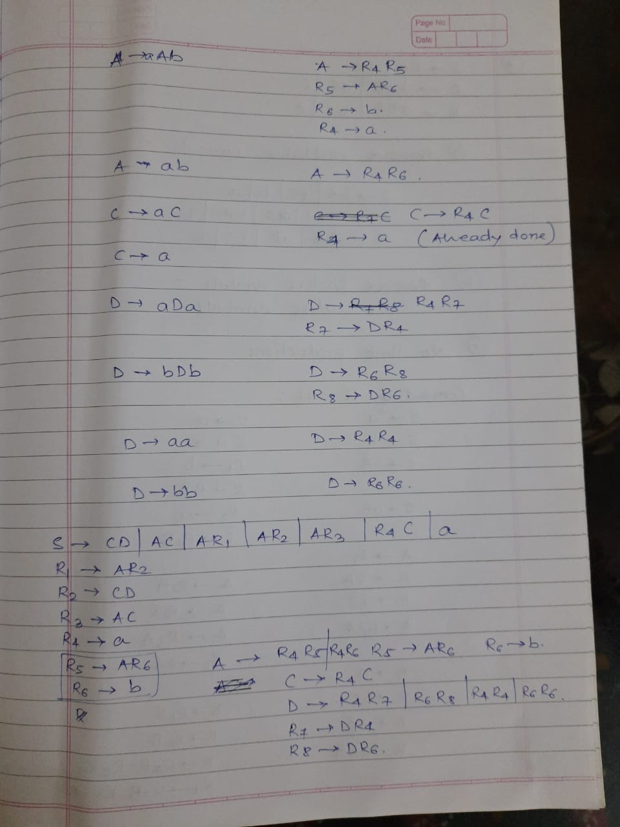

Slide 26
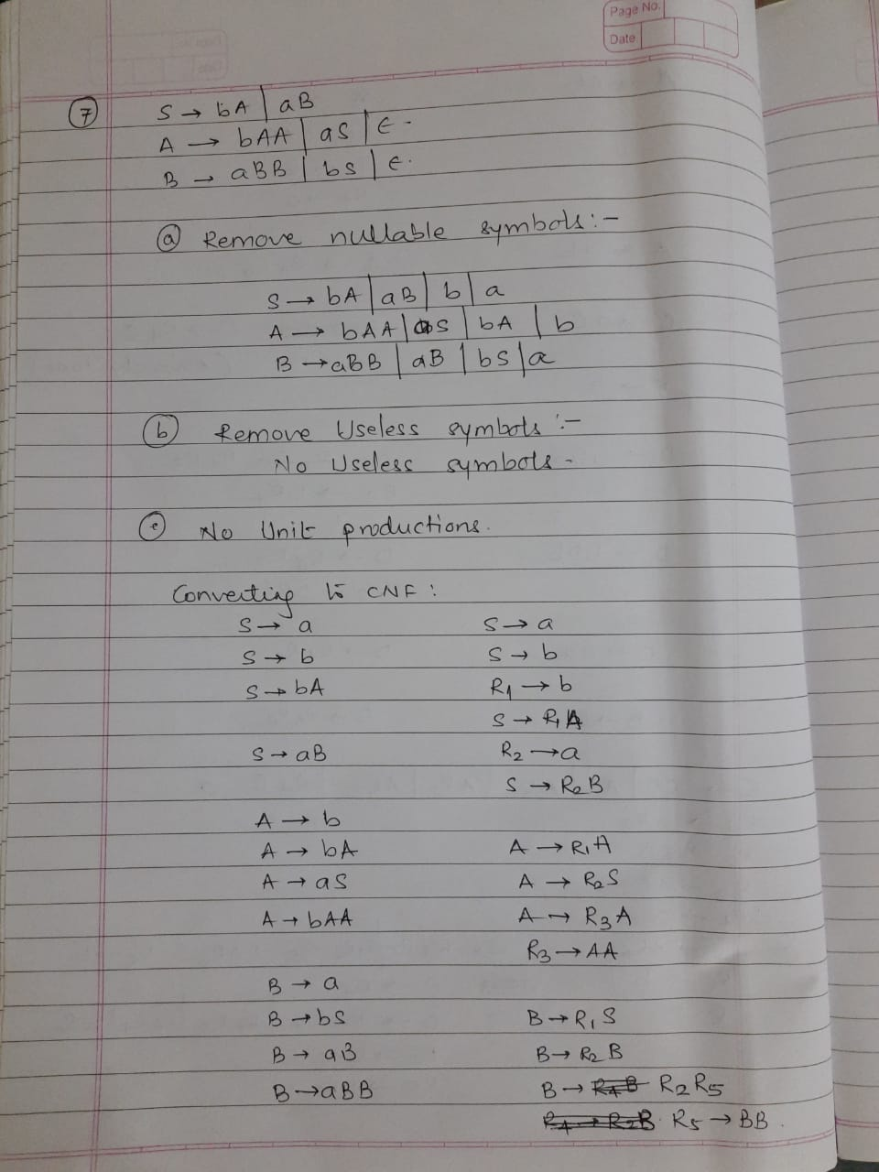

Slide 28
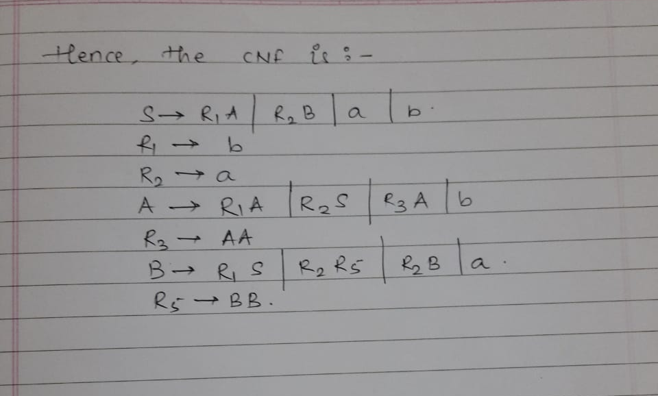

Slide 29
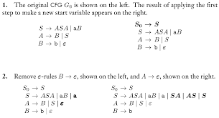

Slide 30
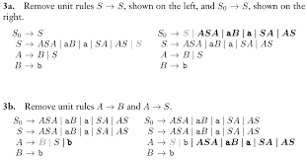

Slide 31
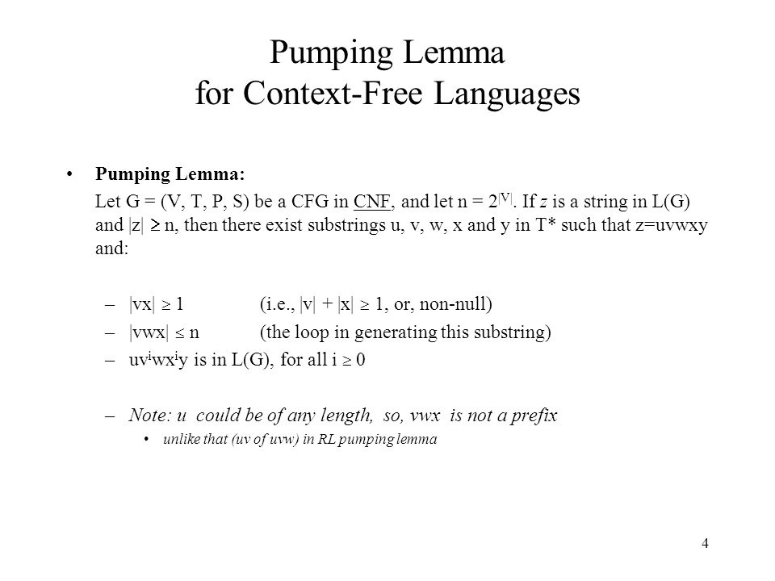

Slide 32
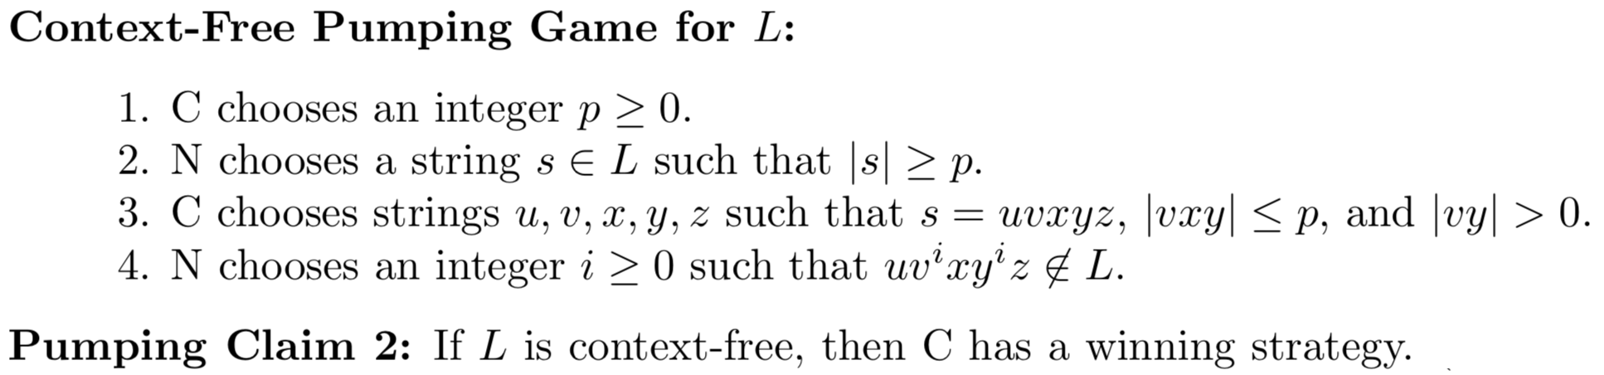

Slide 33
